Slide 1

Dynamic programming (1)
Yongcai Wang
Renmin University of China

Slide 2
主要内容
Introduction to Dynamic Programming
Weighted Interval Scheduling
Longest Common Subsequence
Chain Matrix Multiplication
Infinite Knapsack Problem
0-1 Knapsack Problem
Maximal Independent Set
Optimal Substructure
Dynamic programming algorithm
Floyd-Warshall Algorithm

Slide 3
Sub-problem graph view
Divide-and-conquer:
Big problem
sub-problem
sub-problem
sub-sub-problem
sub-sub-problem
sub-sub-problem
sub-sub-problem
sub-sub-problem

Slide 4
Sub-problem graph view
Greedy algorithms:
Big problem
sub-problem
sub-sub-problem

Slide 5
Sub-problem graph view
Dynamic Programming:
Big problem
sub-problem
sub-problem
sub-problem
sub-sub-problem
sub-sub-problem
sub-sub-problem
sub-sub-problem

Slide 6
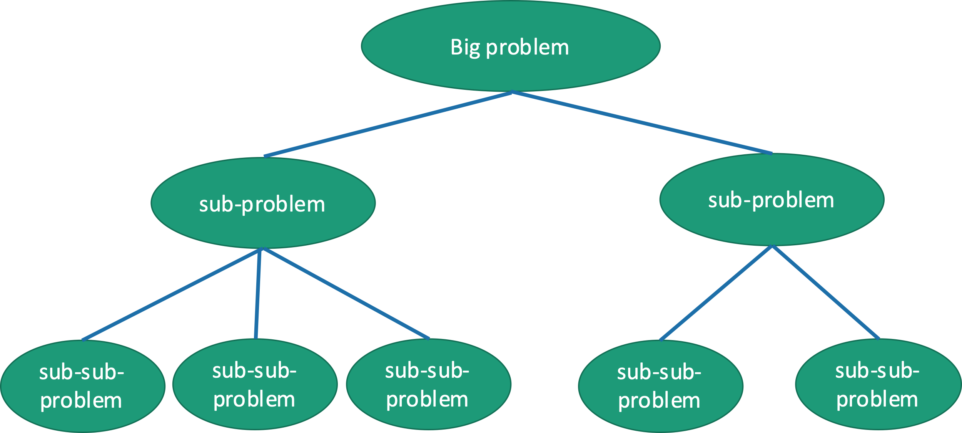
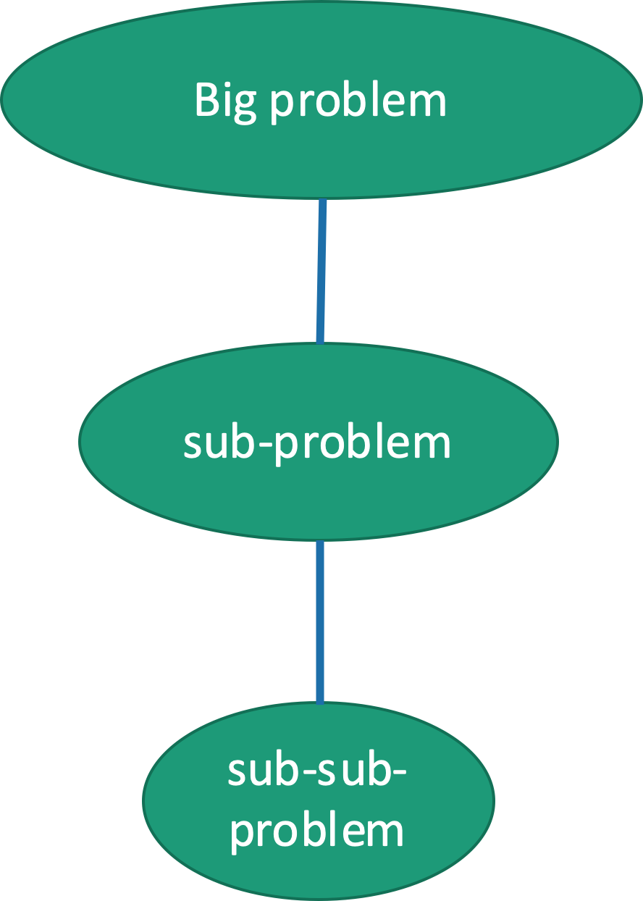
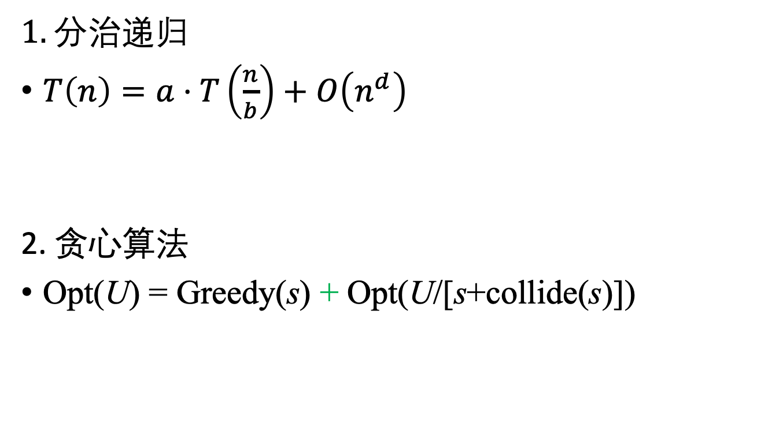
几类问题的最优子问题结构对比
1. 分治递归
$T\left(n\right)=a⋅T\left(\frac{n}{b}\right)+O\left(n^{d}\right)$
2. 贪心算法
Opt(U) = Greedy(s) + Opt(U/[s+collide(s)])
子问题不重叠
子问题不重叠

Slide 7
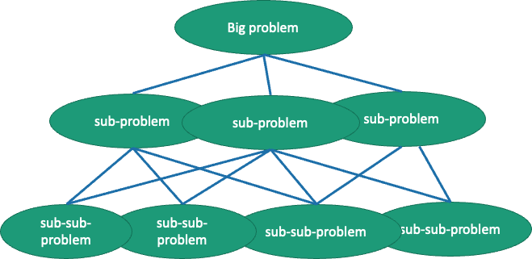
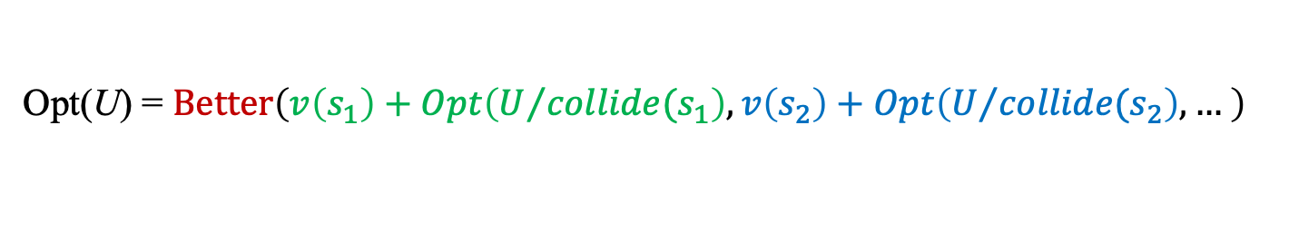
几类问题的最优子问题结构对比
动态规划
Opt(U) = $Better\left(v\left(s_{1}\right)+Opt\left(U/{{collide(s}_{1}}\right),v\left(s_{2}\right)+Opt\left(U/{{collide(s}_{2}}\right), … \right)$
子问题
可能交叠
子问题
可能交叠

Slide 8
Dynamic Programming
Dynamic programming is a powerful technique for solving optimization problems that have certain well-defined clean structural properties.
It breaks problems down into smaller subproblems, which can be solved recursively.
However, unlike divide- and-conquer problems, in which the subproblems are disjoint, in dynamic programming the subproblems typically overlap each other.

Slide 9
Two structure properties of DP
Rely on two important structural qualities, optimal substructure and overlapping subproblems.
Optimal substructure:
For the global problem to be solved optimally, each subproblem should be solved optimally.
Overlapping Subproblems:
Top-Down: A solution to a DP problem is expressed recursively.
Bottom-up: The solution is built iteratively by combining solutions of small subproblems to larger subproblems.

Slide 10
主要内容
Introduction to Dynamic Programming
Weighted Interval Scheduling
Longest Common Subsequence
Chain Matrix Multiplication
Infinite Knapsack Problem
0-1 Knapsack Problem
Maximal Independent Set
Optimal Substructure
Dynamic programming algorithm
Floyd-Warshall Algorithm

Slide 11
Weighted Interval Scheduling
Interval scheduling problem
Optimal weighted interval scheduling problem
Each request is associated with a numeric weight or value, call it v_{i}, and the objective is to find a set of non-overlapping requests such that sum of values is maximized.
No optimal greedy algorithm is known for the weighted version.

Slide 12
DP for weighted interval scheduling
Sort the requests in nondecreasing order of finish time, so that f₁ ≤ . . . ≤ f_{n}.
Consider the last request [s_{n},f_{n}]. There are two possibilities.
If this request is not in the optimum schedule,
we can safely ignore it, and recursively compute the optimum solution of the first n − 1 requests.
Otherwise, this request is in the optimal solution.
We will schedule this request (receiving the profit of v_{n}) and then we must eliminate all the requests whose intervals overlap this one.
How can we select among these two options?

Slide 13
How to select among the two options?
We will compute the cost of both of them recursively, and take the better of the two.
Define p(j) to be the largest integer such that f_{p(j)} < s_{j}
Weighted interval scheduling input and p-values.

Slide 14
Computing the optimum total value.
Definition: For 0 ≤ j ≤ n, opt(j) denotes the maximum possible value achievable if we consider just tasks {1, . . . , j}.
If we have no tasks, then we have no value. opt(0) = 0.
If we can compute opt(j) for each value of j, the maximum value using all the requests is, opt(n).
If request j is not in the optimal schedule:
opt(j) = opt(j − 1)
If request j is in the optimal schedule:
opt(j) = v_{j} + opt(p(j))

Slide 15
DP Selection Principle:
When given a set of feasible options to choose from, try them all and take the best.
There are two options, which suggests the following recursive rule:
Recursive Weighted Interval Scheduling Pseudocode
recursive-WIS(j) {
if (j == 0) return 0
else return max( recursive-WIS(j-1), v[j] + recursive-WIS(p[j]) )
}
不是选一个分支计算，而是递归计算所有子问题，最终算出来最优化指标

Slide 16
The recursive policy in DP
The initial value: opt(0) = 0
opt(j) is related to sub-problem opt(j − 1) and opt(p(j)).
So if we have the optimal values of opt(j − 1) and opt(p(j)), we can calculate opt(j).
So the key idea in DP is:
Finding the relations from opt(j) to some opt(k) where k<j

Slide 17
The computation complexity
recursive-WIS(j) {
if (j == 0) return 0
else return max( recursive-WIS(j-1), v[j] + recursive-WIS(p[j]) )
}
The simple recursive procedure has a terrible running time.
For simplicity, let us suppose that p(j) = j− 2 for all j
Then we need to evaluate opt(j-1) and opt(j-2) for evaluating opt(j).
Therefore T(j) = T(j-1) + T(j-2)
Essentially a Fibonacci series

Slide 18
Speed up by memorizing
Once a value has been computed for recursive-WIS(j) we store the value in a global array M[1..n]. All future attempts to compute this value will simply access the array.
Initialize all the M[j] entries to −1 initially, and use this special value to determine whether an entry has already been computed.
We save a predecessor pointer, pred[j], pointing to where opt(j) comes from: opt(j-1) or opt(p(j))
The value of pred[j] is either j − 1 or p(j)

Slide 19
memoized-WIS(j) {
if (j == 0) return 0
else if (M[j] has been computed) return M[j]
else {
leaveWeight = memoized-WIS(j-1)
takeWeight = v[j] + memoized-WIS(p[j])
if ( leaveWeight > takeWeight )
{
M[j] = leaveWeight
pred[j] = j-1
}
else
{
M[j] = takeWeight
pred[j] = p[j]
}
return M[j];
}
}
//如果已经计算过
//如果j不被选择
//如果j被选择
//如果不被选择
//如果被选择

Slide 20
Running time
The memorized version runs in O(n) time.
Proof:
Each invocation of memoized-WIS either returns in O(1) time (with no recursive calls), or it computes one new entry of M.
Since there are n entries in the table, the latter can occur at most n times.
pred
0
0
2
0
3
5
take
take
leave
take
take
leave
Values and p-values
Progress of MDP

Slide 21
Computing the Final Schedule
Trace M[j] from j=n to j=1
if we arrive at M[j], we check whether pred[j] = p[j]. If so, we know that we did used the jth request. we continue with pred[j] = p[j].
If not, then we know that we did not include request j in the schedule, and we then follow the predecessor link to continue with pred[j] = j − 1

Slide 22
练习：写出每一步的pred[j]
pred[1]= p[1]=0
pred[2]= p[2]=0
pred[3]= j-1 = 2
pred[4]= p[4]=0
pred[5]= p[5]=3
pred[6]= j-1 = 5

Slide 23
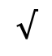


Computing the Final Schedule
get-schedule() {
j = n;
sched = empty;
while (j > 0) {
if (pred[j] == p[j]) {
put j to the front of sched
}
j = pred[j];
}
return sched;
}
// 从空调度表开始
// take request j
// continue with j’s predecessor
// return the final schedule
pred[1]= p[1]=0
pred[2]= p[2]=0
$$√$$
pred[3]= j-1 = 2
$$×$$
sched =[5, 2]
pred[4]= p[4]=0
pred[5]= p[5]=3
$$√$$
pred[6]= j-1 = 5
$$×$$

Slide 24
主要内容
Introduction to Dynamic Programming
Weighted Interval Scheduling
Longest Common Subsequence
Chain Matrix Multiplication
Infinite Knapsack Problem
0-1 Knapsack Problem
Maximal Independent Set
Optimal Substructure
Dynamic programming algorithm
Floyd-Warshall Algorithm

Slide 25
Longest Common Subsequence (LCS)
Finding patterns or similarities within strings is fundamental to various applications.
One common measure of similarity between two strings is the lengths of their longest common subsequence.
An efficient solution to this LCS problem based on dynamic programming.

Slide 26
Longest Common Subsequence
How similar are these two species?
DNA:
DNA:
AGCCCTAAGGGCTACCTAGCTT
GACAGCCTACAAGCGTTAGCTTG

Slide 27
Longest Common Subsequence
How similar are these two species?
Pretty similar, their DNA has a long common subsequence:
DNA:
DNA:
AGCCCTAAGGGCTACCTAGCTT
GACAGCCTACAAGCGTTAGCTTG
AGCCTAAGCTTAGCTT

Slide 28
Longest Common Subsequence
Subsequence:
BDFH is a subsequence of ABCDEFGH
If X and Y are sequences, a common subsequence is a sequence which is a subsequence of both.
BDFH is a common subsequence of ABCDEFGH and of ABDFGHI
A longest common subsequence…
…is a common subsequence that is longest.
The longest common subsequence of ABCDEFGH and ABDFGHI is ABDFGH.

Slide 29
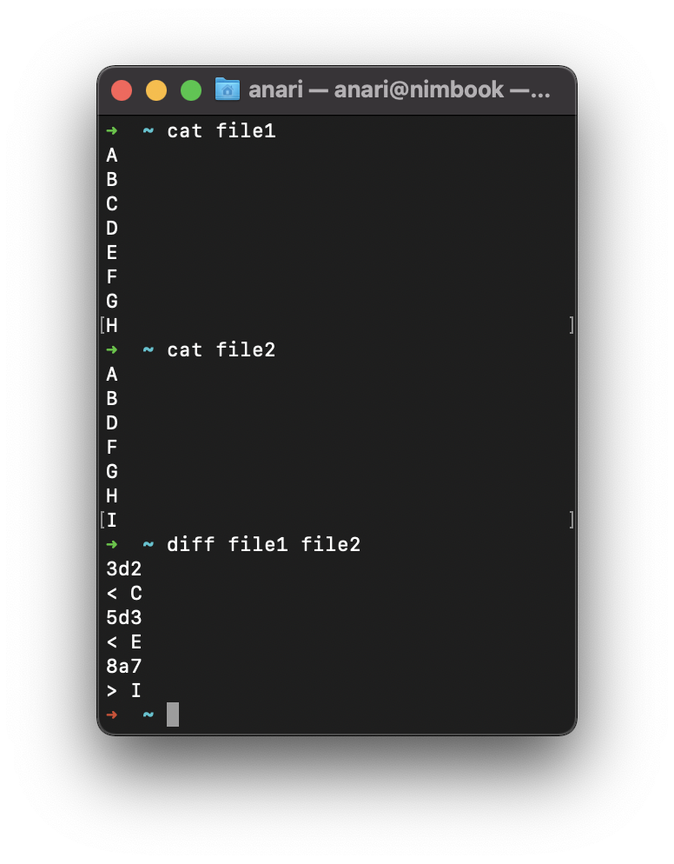
We sometimes want to find these
Applications in bioinformatics
The unix command diff
Merging in version control
svn, git, etc…

Slide 30
Recipe for applying Dynamic Programming
Step 1: Identify optimal substructure.
Step 2: Find a recursive formulation for the length of the longest common subsequence.
Step 3: Use dynamic programming to find the length of the longest common subsequence.
Step 4: If needed, keep track of some additional info so that the algorithm from Step 3 can find the actual LCS.
Step 5: If needed, code this up like a reasonable person.

Slide 31
Step 1: Optimal substructure
Prefixes:
X
A
C
G
G
T
Y
A
C
G
C
T
T
A
Notation: denote this prefix ACGC by Y₄
Our sub-problems will be finding LCS’s of prefixes to X and Y.
Let C[i,j] = length_of_LCS( X_{i}, Y_{j} )
Examples:
C[2,3] = 2
C[4,4] = 3

Slide 32
Recipe for applying Dynamic Programming
Step 1: Identify optimal substructure.
Step 2: Find a recursive formulation for the length of the longest common subsequence.
Step 3: Use dynamic programming to find the length of the longest common subsequence.
Step 4: If needed, keep track of some additional info so that the algorithm from Step 3 can find the actual LCS.
Step 5: If needed, code this up like a reasonable person.

Slide 33
Goal
Write C[i,j] in terms of the solutions to smaller sub-problems
i
X_{i}
A
C
G
G
A
j
Y_{j}
A
C
G
C
T
T
A
C[i,j] = length_of_LCS( X_{i}, Y_{j} )

Slide 34
Two cases
Our sub-problems will be finding LCS’s of prefixes to X and Y.
Let C[i,j] = length_of_LCS( X_{i}, Y_{j} )
Case 1: X[i] = Y[j]
i
These are the same
X_{i}
A
C
G
G
A
j
Y_{j}
A
C
G
C
T
T
A
Then C[i,j] = 1 + C[i-1,j-1].
because LCS(X_{i},Y_{j}) = LCS(X_{i-1},Y_{j-1}) followed by
A

Slide 35
Two cases
Our sub-problems will be finding LCS’s of prefixes to X and Y.
Let C[i,j] = length_of_LCS( X_{i}, Y_{j} )
Case 2: X[i] != Y[j]
i
These are not the same
X_{i}
A
C
G
G
T
j
Y_{j}
A
C
G
C
T
T
A
Then C[i,j] = max{ C[i-1,j], C[i,j-1] }.
either LCS(X_{i},Y_{j}) = LCS(X_{i-1},Y_{j}) and is not involved,
or LCS(X_{i},Y_{j}) = LCS(X_{i},Y_{j-1}) and is not involved,
(maybe both are not involved, that’s covered by the “or”).
T
A

Slide 36
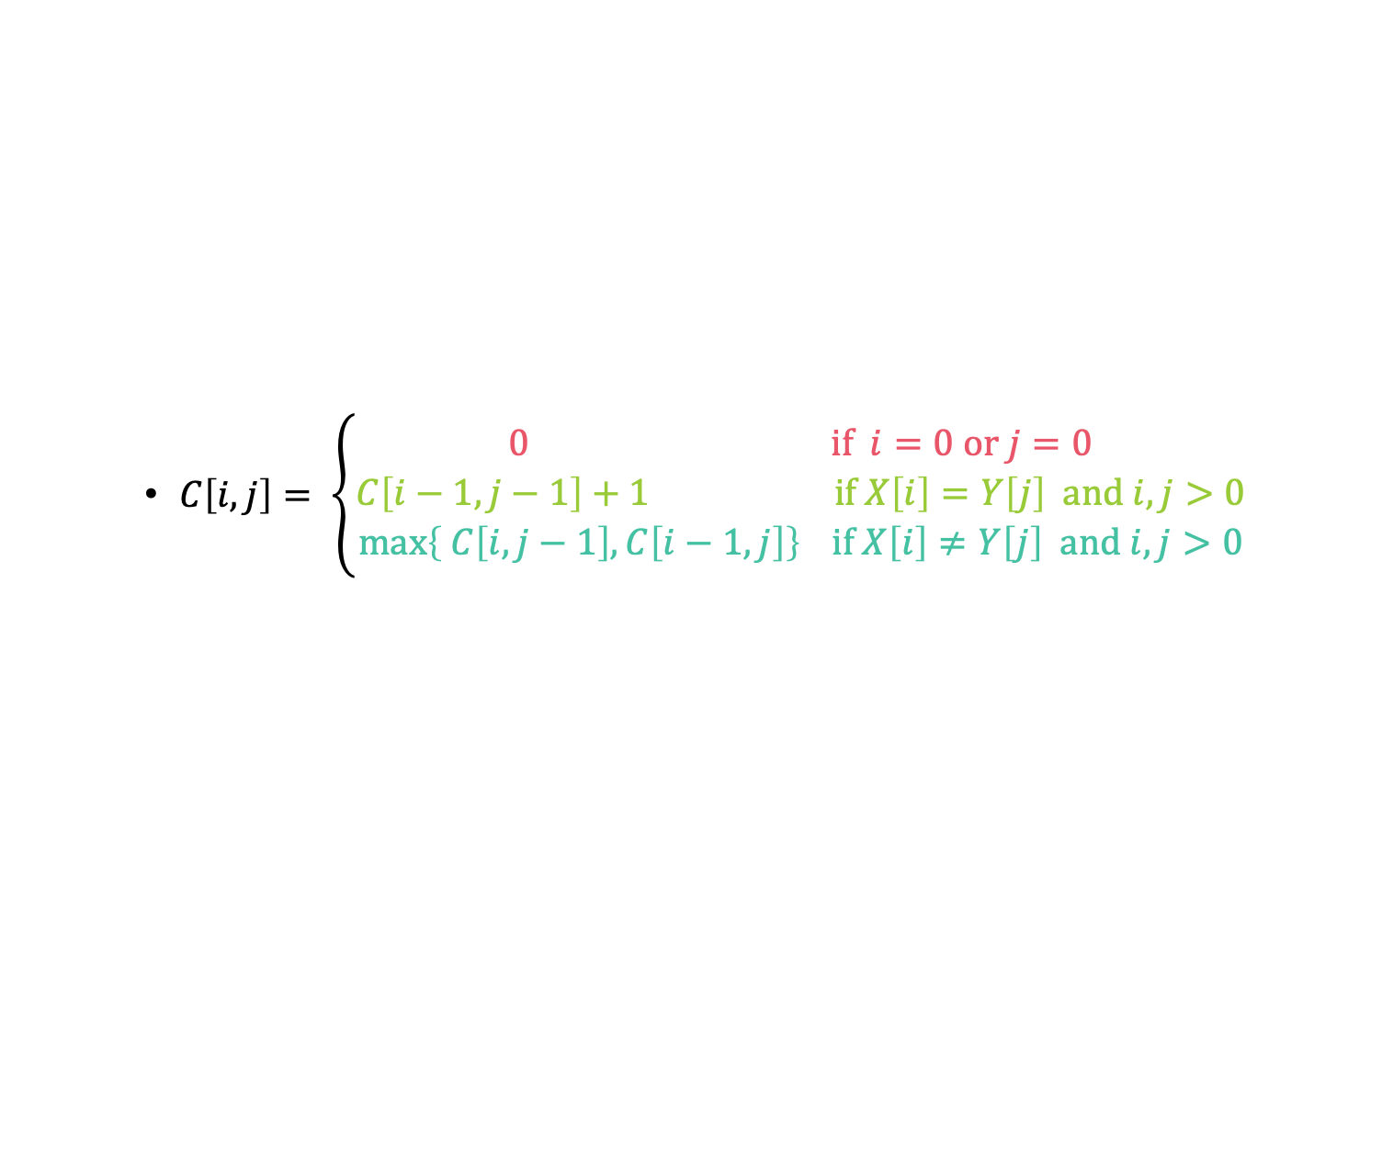
Recursive formulation of the optimal solution
X₀
Y_{j}
A
C
G
C
T
T
A
Case 0
$C\left[i,j\right]= \left\{\begin{aligned}0 \text{if} i=0 \text{or} j=0 \\ C\left[i−1,j−1\right]+1 \text{if} X\left[i\right]=Y\left[j\right] \text{and} i,j>0 \\ \max\left\{ C\left[i,j−1\right], C\left[i−1,j\right]\right\} \text{if} X\left[i\right]≠Y\left[j\right] \text{and} i,j>0\end{aligned}\right.$
Case 1
Case 2
X_{i}
A
C
G
G
A
X_{i}
A
C
G
G
T
Y_{j}
A
C
G
C
T
T
A
Y_{j}
A
C
G
C
T
T
A

Slide 37
Recipe for applying Dynamic Programming
Step 1: Identify optimal substructure.
Step 2: Find a recursive formulation for the length of the longest common subsequence.
Step 3: Use dynamic programming to find the length of the longest common subsequence.
Step 4: If needed, keep track of some additional info so that the algorithm from Step 3 can find the actual LCS.
Step 5: If needed, code this up like a reasonable person.

Slide 38

LCS DP
LCS(X, Y):
C[i,0] = C[0,j] = 0 for all i = 0,…,m, j=0,…n.
For i = 1,…,m and j = 1,…,n:
If X[i] = Y[j]:
C[i,j] = C[i-1,j-1] + 1
Else:
C[i,j] = max{ C[i,j-1], C[i-1,j] }
Return C[m,n]
Running time: O(nm)
$$C\left[i,j\right]= \left\{\begin{aligned}0 \text{if} i=0 \text{or} j=0 \\ C\left[i−1,j−1\right]+1 \text{if} X\left[i\right]=Y\left[j\right] \text{and} i,j>0 \\ \max\left\{ C\left[i,j−1\right], C\left[i−1,j\right]\right\} \text{if} X\left[i\right]≠Y\left[j\right] \text{and} i,j>0\end{aligned}\right.$$

Slide 39

Example
X
A
C
G
G
A
Y
A
C
T
G
Y
A
C
T
G
0
0
0
0
0
A
0
C
0
X
G
0
G
0
A
0
$$C\left[i,j\right]= \left\{\begin{aligned}0 \text{if} i=0 \text{or} j=0 \\ C\left[i−1,j−1\right]+1 \text{if} X\left[i\right]=Y\left[j\right] \text{and} i,j>0 \\ \max\left\{ C\left[i,j−1\right], C\left[i−1,j\right]\right\} \text{if} X\left[i\right]≠Y\left[j\right] \text{and} i,j>0\end{aligned}\right.$$

Slide 40
Example
X
A
C
G
G
A
Y
A
C
T
G
Y
A
C
T
G
0
0
0
0
0
0
0
0
0
0
0
So the LCM of X and Y has length 3.
A
0
1
1
1
1
0
C
0
1
2
2
2
X
0
G
0
1
2
2
3
0
G
0
1
2
2
3
0
A
0
1
2
2
3
$$C\left[i,j\right]= \left\{\begin{aligned}0 \text{if} i=0 \text{or} j=0 \\ C\left[i−1,j−1\right]+1 \text{if} X\left[i\right]=Y\left[j\right] \text{and} i,j>0 \\ \max\left\{ C\left[i,j−1\right], C\left[i−1,j\right]\right\} \text{if} X\left[i\right]≠Y\left[j\right] \text{and} i,j>0\end{aligned}\right.$$

Slide 41
Recipe for applying Dynamic Programming
Step 1: Identify optimal substructure.
Step 2: Find a recursive formulation for the length of the longest common subsequence.
Step 3: Use dynamic programming to find the length of the longest common subsequence.
Step 4: If needed, keep track of some additional info so that the algorithm from Step 3 can find the actual LCS.
Step 5: If needed, code this up like a reasonable person.

Slide 42
Example
X
A
C
G
G
A
Y
A
C
T
G
Y
A
C
T
G
0
0
0
0
0
A
0
C
0
X
G
0
G
0
A
0
$$C\left[i,j\right]= \left\{\begin{aligned}0 \text{if} i=0 \text{or} j=0 \\ C\left[i−1,j−1\right]+1 \text{if} X\left[i\right]=Y\left[j\right] \text{and} i,j>0 \\ \max\left\{ C\left[i,j−1\right], C\left[i−1,j\right]\right\} \text{if} X\left[i\right]≠Y\left[j\right] \text{and} i,j>0\end{aligned}\right.$$

Slide 43
Example
X
A
C
G
G
A
Y
A
C
T
G
Y
A
C
T
G
0
0
0
0
0
0
0
0
0
0
0
A
0
1
1
1
1
0
C
0
1
2
2
2
X
0
G
0
1
2
2
3
0
G
0
1
2
2
3
0
A
0
1
2
2
3
$$C\left[i,j\right]= \left\{\begin{aligned}0 \text{if} i=0 \text{or} j=0 \\ C\left[i−1,j−1\right]+1 \text{if} X\left[i\right]=Y\left[j\right] \text{and} i,j>0 \\ \max\left\{ C\left[i,j−1\right], C\left[i−1,j\right]\right\} \text{if} X\left[i\right]≠Y\left[j\right] \text{and} i,j>0\end{aligned}\right.$$

Slide 44
Example
X
A
C
G
G
A
Y
A
C
T
G
Y
A
C
T
G
Once we’ve filled this in, we can work backwards.
0
0
0
0
0
0
0
0
0
0
0
A
0
1
1
1
1
0
C
0
1
2
2
2
X
0
G
0
1
2
2
3
0
G
0
1
2
2
3
0
A
0
1
2
2
3
$$C\left[i,j\right]= \left\{\begin{aligned}0 \text{if} i=0 \text{or} j=0 \\ C\left[i−1,j−1\right]+1 \text{if} X\left[i\right]=Y\left[j\right] \text{and} i,j>0 \\ \max\left\{ C\left[i,j−1\right], C\left[i−1,j\right]\right\} \text{if} X\left[i\right]≠Y\left[j\right] \text{and} i,j>0\end{aligned}\right.$$

Slide 45
Example
X
A
C
G
G
A
Y
A
C
T
G
Y
A
C
T
G
Once we’ve filled this in, we can work backwards.
0
0
0
0
0
0
0
0
0
0
0
A
0
1
1
1
1
0
C
0
1
2
2
2
X
0
G
0
1
2
2
3
0
G
0
1
2
2
3
That 3 must have come from the 3 above it.
0
A
0
1
2
2
3
$$C\left[i,j\right]= \left\{\begin{aligned}0 \text{if} i=0 \text{or} j=0 \\ C\left[i−1,j−1\right]+1 \text{if} X\left[i\right]=Y\left[j\right] \text{and} i,j>0 \\ \max\left\{ C\left[i,j−1\right], C\left[i−1,j\right]\right\} \text{if} X\left[i\right]≠Y\left[j\right] \text{and} i,j>0\end{aligned}\right.$$

Slide 46
Example
X
A
C
G
G
A
Y
A
C
T
G
Y
A
C
T
G
Once we’ve filled this in, we can work backwards.
Once we’ve filled this in, we can work backwards.
A diagonal jump means that we found an element of the LCS!
0
0
0
0
0
0
0
0
0
0
0
A
0
1
1
1
1
0
C
0
1
2
2
2
X
0
G
0
1
2
2
3
G
This 3 came from that 2 – we found a match!
0
G
0
1
2
2
3
0
A
0
1
2
2
3
$$C\left[i,j\right]= \left\{\begin{aligned}0 \text{if} i=0 \text{or} j=0 \\ C\left[i−1,j−1\right]+1 \text{if} X\left[i\right]=Y\left[j\right] \text{and} i,j>0 \\ \max\left\{ C\left[i,j−1\right], C\left[i−1,j\right]\right\} \text{if} X\left[i\right]≠Y\left[j\right] \text{and} i,j>0\end{aligned}\right.$$

Slide 47
Example
X
A
C
G
G
A
Y
A
C
T
G
Y
A
C
T
G
Once we’ve filled this in, we can work backwards.
A diagonal jump means that we found an element of the LCS!
0
0
0
0
0
0
0
0
0
0
0
A
0
1
1
1
1
0
C
0
1
2
2
2
That 2 may as well have come from this other 2.
X
0
G
0
1
2
2
3
G
0
G
0
1
2
2
3
0
A
0
1
2
2
3
$$C\left[i,j\right]= \left\{\begin{aligned}0 \text{if} i=0 \text{or} j=0 \\ C\left[i−1,j−1\right]+1 \text{if} X\left[i\right]=Y\left[j\right] \text{and} i,j>0 \\ \max\left\{ C\left[i,j−1\right], C\left[i−1,j\right]\right\} \text{if} X\left[i\right]≠Y\left[j\right] \text{and} i,j>0\end{aligned}\right.$$

Slide 48
Example
X
A
C
G
G
A
Y
A
C
T
G
Y
A
C
T
G
Once we’ve filled this in, we can work backwards.
A diagonal jump means that we found an element of the LCS!
0
0
0
0
0
0
0
0
0
0
0
A
0
1
1
1
1
0
C
0
1
2
2
2
X
0
G
0
1
2
2
3
G
0
G
0
1
2
2
3
0
A
0
1
2
2
3
$$C\left[i,j\right]= \left\{\begin{aligned}0 \text{if} i=0 \text{or} j=0 \\ C\left[i−1,j−1\right]+1 \text{if} X\left[i\right]=Y\left[j\right] \text{and} i,j>0 \\ \max\left\{ C\left[i,j−1\right], C\left[i−1,j\right]\right\} \text{if} X\left[i\right]≠Y\left[j\right] \text{and} i,j>0\end{aligned}\right.$$

Slide 49
Example
X
A
C
G
G
A
Y
A
C
T
G
Y
A
C
T
G
Once we’ve filled this in, we can work backwards.
A diagonal jump means that we found an element of the LCS!
0
0
0
0
0
0
0
0
0
0
0
A
0
1
1
1
1
0
C
0
1
2
2
2
X
0
G
0
1
2
2
3
C
G
0
G
0
1
2
2
3
0
A
0
1
2
2
3
$$C\left[i,j\right]= \left\{\begin{aligned}0 \text{if} i=0 \text{or} j=0 \\ C\left[i−1,j−1\right]+1 \text{if} X\left[i\right]=Y\left[j\right] \text{and} i,j>0 \\ \max\left\{ C\left[i,j−1\right], C\left[i−1,j\right]\right\} \text{if} X\left[i\right]≠Y\left[j\right] \text{and} i,j>0\end{aligned}\right.$$

Slide 50
Example
X
A
C
G
G
A
Y
A
C
T
G
Y
A
C
T
G
Once we’ve filled this in, we can work backwards.
A diagonal jump means that we found an element of the LCS!
0
0
0
0
0
0
0
0
0
0
0
A
0
1
1
1
1
0
C
0
1
2
2
2
X
0
G
0
1
2
2
3
A
C
G
0
G
0
1
2
2
3
This is the LCS!
0
A
0
1
2
2
3
$$C\left[i,j\right]= \left\{\begin{aligned}0 \text{if} i=0 \text{or} j=0 \\ C\left[i−1,j−1\right]+1 \text{if} X\left[i\right]=Y\left[j\right] \text{and} i,j>0 \\ \max\left\{ C\left[i,j−1\right], C\left[i−1,j\right]\right\} \text{if} X\left[i\right]≠Y\left[j\right] \text{and} i,j>0\end{aligned}\right.$$

Slide 51
Finding an LCS
Good exercise to write out pseudocode for what we just saw!
Or you can find it in lecture notes.
Takes time O(mn) to fill the table
Takes time O(n + m) on top of that to recover the LCS
We walk up and left in an n-by-m array
We can only do that for n + m steps.
Altogether, we can find LCS(X,Y) in time O(mn).

Slide 52
Recipe for applying Dynamic Programming
Step 1: Identify optimal substructure.
Step 2: Find a recursive formulation for the length of the longest common subsequence.
Step 3: Use dynamic programming to find the length of the longest common subsequence.
Step 4: If needed, keep track of some additional info so that the algorithm from Step 3 can find the actual LCS.
Step 5: If needed, code this up like a reasonable person.

Slide 53
Our approach actually isn’t so bad
If we are only interested in the length of the LCS we can do a bit better on space:
Since we go across the table one-row-at-a-time, we can only keep two rows if we want.
If we want to recover the LCS, we need to keep the whole table.

Slide 54
What have we learned?
We can find LCS(X,Y) in time O(nm)
if |Y|=n, |X|=m
We went through the steps of coming up with a dynamic programming algorithm.
We kept a 2-dimensional table, breaking down the problem by decrementing the length of X and Y.

Slide 55
主要内容
Introduction to Dynamic Programming
Weighted Interval Scheduling
Longest Common Subsequence
Chain Matrix Multiplication
Infinite Knapsack Problem
0-1 Knapsack Problem
Maximal Independent Set
Optimal Substructure
Dynamic programming algorithm
Floyd-Warshall Algorithm

Slide 56
Chain Matrix Multiplication

Slide 57
Chain Matrix Multiplication
考虑进行的乘法的次数

Slide 58
Chain Matrix Multiplication
Consider the case of 3 matrices: A₁ be 5 × 4, A₂ be 4 × 6 and A₃ be 6 × 2
Chain Matrix Multiplication Problem: Given a sequence of matrices A₁, . . . , A_{n} and dimensions p₀, . . . , p_{n} where A_{i} is of dimension p_{i−1} × p_{i}, determine the order of multiplication (represented, say, as a binary tree) that minimizes the number of operations.

Slide 59
Dynamic programming approach
Let A_{i..j} denote the result of multiplying matrices i through j. A_{i..j} is a p_{i−1} × p_{j} matrix.
At the highest level, it is to select a point to decompose the sequence multiplication.
This reduces to two problems:
What is the best place to split the chain? (what is k?)
How do we further split each of the subsequences A_{1..k} and A_{k+1..n}?

Slide 60
Recursive formulation
For 1 ≤ i ≤ j ≤ n, let m(i,j) denote the minimum number of multiplications needed to compute A_{i..j}.

Slide 61
Recursive formulation
we store the values of m(i, j ) in a 2-dimensional array m[1..n, 1..n].
In the process of computing m(i, j) we need to access values m(i, k) and m(k + 1, j) for k lying between i and j.
We cannot compute m[][] row-by-row, because calculating m[3][5] will need m[4][5] which has not been calculated yet.
We first solve the problem for chains of length 1 (which is trivial), then chains of length 2, and so on, until we come to m[1, n], which is the total chain of length n.

Slide 62
Recursive formulation
Let L = j − i + 1 denote the length of the subchain being multiplied.
For L=1, m[i][i]=0;
If a subchain of length L starts at position i, then j=i+L−1.

Slide 63
DP based chain matrix multiplication
Matrix-Chain(p[0..n]) {
m = array[1..n, 1..n]
s = array[1..n-1, 2..n]
for (i = 1 to n) m[i, i] = 0
for (L = 2 to n) {
for (i = 1 to n - L + 1) {
j=i+L-1
m[i,j] = INFINITY
for (k = i to j - 1) {
cost = m[i, k] + m[k+1, j] + p[i-1]*p[k]*p[j]
if (cost < m[i, j]) {
m[i, j] = cost
s[i, j] = k
}
}
}
}
return m[1, n] (final cost) and s (splitting markers)
}
// initialize
// L = length of subchain
// check all splits
Complexity O(n³)

Slide 64
基于动态规划的链式矩阵乘法
s[i,j]
Matrix-Chain(p[0..n]) {
m = array[1..n, 1..n]
s = array[1..n-1, 2..n]
for (i = 1 to n) m[i, i] = 0
for (L = 2 to n) {
for (i = 1 to n - L + 1) {
j=i+L-1
m[i,j] = INFINITY
for (k = i to j - 1) {
cost = m[i, k] + m[k+1, j] + p[i-1]*p[k]*p[j]
if (cost < m[i, j]) {
m[i, j] = cost
s[i, j] = k
}
}
}
}
}
4
1
j
3
i
3
2
1
3
2
3
1
2
3
m[i,j]
4
1
j
158
i
3
2
4*6*2+5*4*2
88
104
2
3
120
48
84
1
4
0
0
0
0
5
A₁
4
A₂
6
A₃
2
A₄
7
p₀
p₁
p₂
p₃
p₄

Slide 65
DP based chain matrix multiplication

Slide 66
根据记录的k计算矩阵乘法
do-mult(i, j) {
if (i == j)
return A[i]
else {
k = s[i,j]
X = do-mult(i, k)
Y = do-mult(k+1, j)
return X * Y
}
}
k=s[1,4]=3
X=do-multi(1,3)
Y=do-multi(4,4)
X*A₄
k=s[1,3]=1
X=do-multi(1,1)
Y=do-multi(2,3)
A₁*Y*A₄
k=s[2,3]=2
X=do-multi(2,2)
Y=do-multi(3,3)
A₁A₂ A₃ A₄

Slide 67
练习
直观上总结一下矩阵链式乘法
5 4 6 2 7
5 4 2 7
5 2 7
5 7
贪心算法和动态规划究竟是否有差异呢？
50 10 40 30 5
贪心算法的话，总乘法次数是多少？
动态规划的话，总乘法次数是多少？
有相邻的三个数中间大两边小的优先计算
看似可以设计一种贪心机制
可以设计一种贪心算法来进行矩阵链式乘法

Slide 68
主要内容
Introduction to Dynamic Programming
Weighted Interval Scheduling
Longest Common Subsequence
Chain Matrix Multiplication
Infinite Knapsack Problem
0-1 Knapsack Problem
Maximal Independent Set
Optimal Substructure
Dynamic programming algorithm
Floyd-Warshall Algorithm

Slide 69
Example 4: Knapsack Problem
We have n items with weights and values:
And we have a knapsack:
it can only carry so much weight:
Item:
Weight:
6
2
4
3
11
Value:
20
8
14
13
35
Capacity: 10

Slide 70
Item:
Weight:
6
2
4
3
11
Capacity: 10
Value:
20
8
14
13
35
Unbounded Knapsack:
Suppose I have infinite copies of all items.
What’s the most valuable way to fill the knapsack?
0/1 Knapsack:
Suppose I have only one copy of each item.
What’s the most valuable way to fill the knapsack?
Total weight: 10
Total value: 42
Total weight: 9
Total value: 35

Slide 71
Some notation
Item:
…
w₁
w₂
w₃
w_{n}
Weight:
v₁
v₂
v₃
v_{n}
Value:
Capacity: W

Slide 72
Recipe for applying Dynamic Programming
Step 1: Identify optimal substructure.
Step 2: Find a recursive formulation for the value of the optimal solution.
Step 3: Use dynamic programming to find the value of the optimal solution.
Step 4: If needed, keep track of some additional info so that the algorithm from Step 3 can find the actual solution.
Step 5: If needed, code this up like a reasonable person.

Slide 73
Optimal substructure
Sub-problems:
Unbounded Knapsack with a smaller knapsack.
K[x] = value you can fit in a knapsack of capacity x
First solve the problem for small knapsacks
Then larger knapsacks
Then larger knapsacks

Slide 74
Optimal substructure
item i
Suppose this is an optimal solution for capacity x:
Then this is optimal for capacity x - w_{i}:
Say that the optimal solution contains at least one copy of item i.
Weight w_{i}
Value v_{i}
Capacity x
Value V
Why?
1 minute think
(wait) 1 minute share
Capacity x – w_{i}
Value V - v_{i}

Slide 75
Optimal substructure
item i
Suppose this is an optimal solution for capacity x:
Then this is optimal for capacity x - w_{i}:
Say that the optimal solution contains at least one copy of item i.
Weight w_{i}
Value v_{i}
Capacity x
Value V
If I could do better than the second solution, then adding a turtle to that improvement would improve the first solution.
Capacity x – w_{i}
Value V - v_{i}

Slide 76
Recipe for applying Dynamic Programming
Step 1: Identify optimal substructure.
Step 2: Find a recursive formulation for the value of the optimal solution.
Step 3: Use dynamic programming to find the value of the optimal solution.
Step 4: If needed, keep track of some additional info so that the algorithm from Step 3 can find the actual solution.
Step 5: If needed, code this up like a reasonable person.

Slide 77
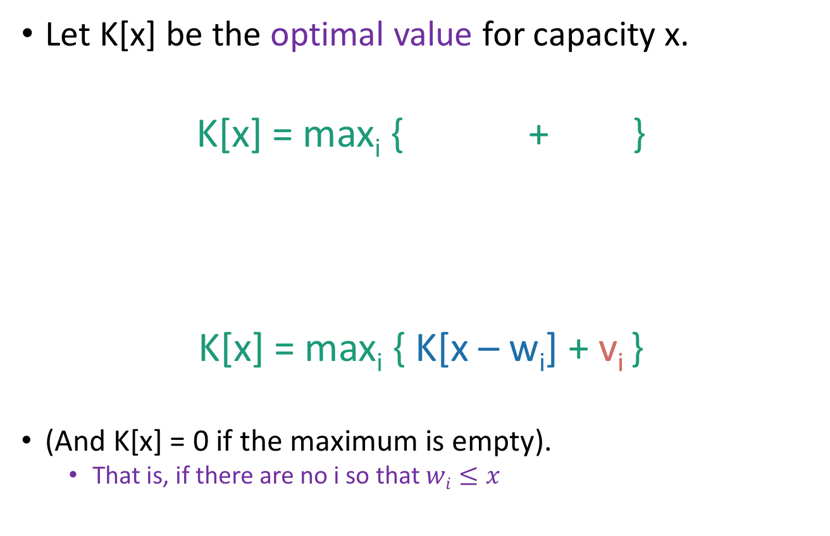
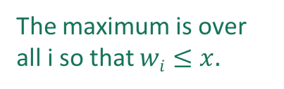
Recursive relationship
Let K[x] be the optimal value for capacity x.
K[x] = max_{i} { + }
K[x] = max_{i} { K[x – w_{i}] + v_{i} }
(And K[x] = 0 if the maximum is empty).
That is, if there are no i so that $wi≤x$
The maximum is over all i so that $wi≤x.$
Optimal way to fill the smaller knapsack
The value of item i.

Slide 78
Recipe for applying Dynamic Programming
Step 1: Identify optimal substructure.
Step 2: Find a recursive formulation for the value of the optimal solution.
Step 3: Use dynamic programming to find the value of the optimal solution.
Step 4: If needed, keep track of some additional info so that the algorithm from Step 3 can find the actual solution.
Step 5: If needed, code this up like a reasonable person.

Slide 79
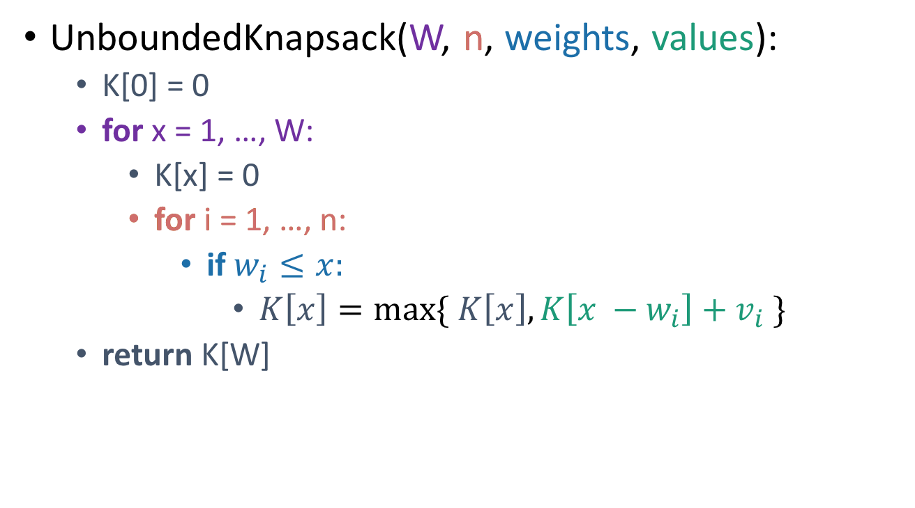
Let’s write a bottom-up DP algorithm
UnboundedKnapsack(W, n, weights, values):
K[0] = 0
for x = 1, …, W:
K[x] = 0
for i = 1, …, n:
if $w_{i}≤x:$
$K\left[x\right]=\max{\{ K\left[x\right], K\left[x −w_{i}\right]+v_{i} \}}$
return K[W]
Running time: O(nW)
K[x] = max_{i} { + }
= max_{i} { K[x – w_{i}] + v_{i} }

Slide 80
Recipe for applying Dynamic Programming
Step 1: Identify optimal substructure.
Step 2: Find a recursive formulation for the value of the optimal solution.
Step 3: Use dynamic programming to find the value of the optimal solution.
Step 4: If needed, keep track of some additional info so that the algorithm from Step 3 can find the actual solution.
Step 5: If needed, code this up like a reasonable person.

Slide 81
Let’s write a bottom-up DP algorithm
UnboundedKnapsack(W, n, weights, values):
K[0] = 0
for x = 1, …, W:
K[x] = 0
for i = 1, …, n:
if $w_{i}≤x:$
$K\left[x\right]=\max{\{ K\left[x\right], K\left[x −w_{i}\right]+v_{i} \}}$
return K[W]
K[x] = max_{i} { + }
= max_{i} { K[x – w_{i}] + v_{i} }

Slide 82
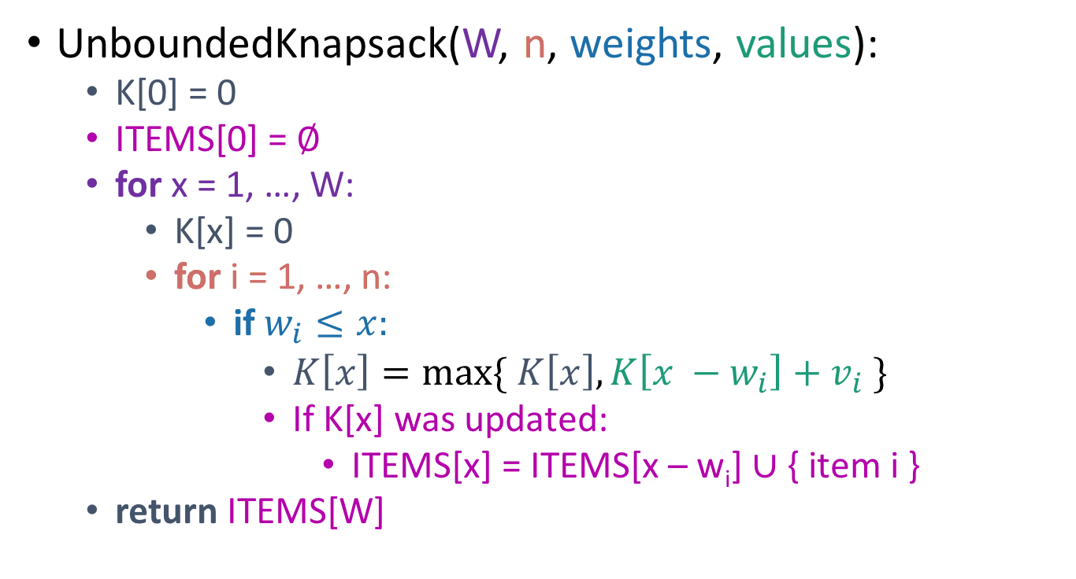
Let’s write a bottom-up DP algorithm
UnboundedKnapsack(W, n, weights, values):
K[0] = 0
ITEMS[0] = $∅$
for x = 1, …, W:
K[x] = 0
for i = 1, …, n:
if $w_{i}≤x:$
$K\left[x\right]=\max{\{ K\left[x\right], K\left[x −w_{i}\right]+v_{i} \}}$
If K[x] was updated:
ITEMS[x] = ITEMS[x – w_{i}] $∪$ { item i }
return ITEMS[W]
K[x] = max_{i} { + }
= max_{i} { K[x – w_{i}] + v_{i} }

Slide 83
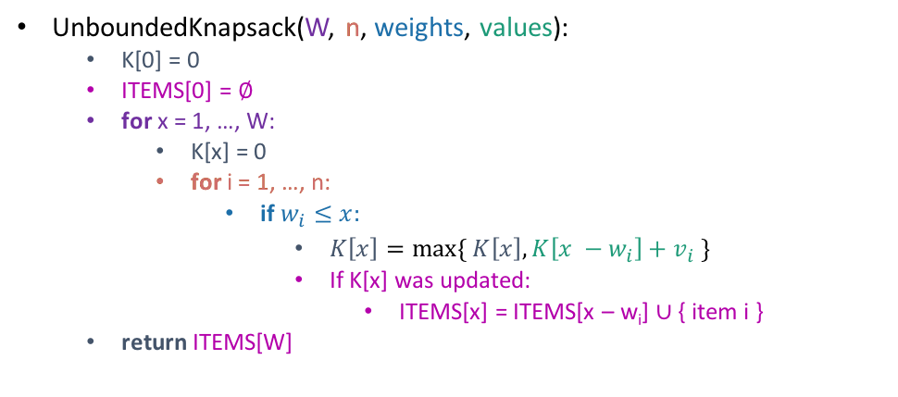
Example
UnboundedKnapsack(W, n, weights, values):
K[0] = 0
ITEMS[0] = $∅$
for x = 1, …, W:
K[x] = 0
for i = 1, …, n:
if $w_{i}≤x:$
$K\left[x\right]=\max{\{ K\left[x\right], K\left[x −w_{i}\right]+v_{i} \}}$
If K[x] was updated:
ITEMS[x] = ITEMS[x – w_{i}] $∪$ { item i }
return ITEMS[W]
0
1
2
3
4
0
K
ITEMS
Item:
Weight:
1
2
3
Value:
1
4
6
Capacity: 4

Slide 84
Example
UnboundedKnapsack(W, n, weights, values):
K[0] = 0
ITEMS[0] = $∅$
for x = 1, …, W:
K[x] = 0
for i = 1, …, n:
if $w_{i}≤x:$
$K\left[x\right]=\max{\{ K\left[x\right], K\left[x −w_{i}\right]+v_{i} \}}$
If K[x] was updated:
ITEMS[x] = ITEMS[x – w_{i}] $∪$ { item i }
return ITEMS[W]
0
1
2
3
4
0
1
K
ITEMS
Item:
Weight:
1
2
3
Value:
1
4
6
ITEMS[1] = ITEMS[0] +
Capacity: 4

Slide 85
Example
UnboundedKnapsack(W, n, weights, values):
K[0] = 0
ITEMS[0] = $∅$
for x = 1, …, W:
K[x] = 0
for i = 1, …, n:
if $w_{i}≤x:$
$K\left[x\right]=\max{\{ K\left[x\right], K\left[x −w_{i}\right]+v_{i} \}}$
If K[x] was updated:
ITEMS[x] = ITEMS[x – w_{i}] $∪$ { item i }
return ITEMS[W]
0
1
2
3
4
0
1
2
K
ITEMS
Item:
Weight:
1
2
3
Value:
1
4
6
ITEMS[2] = ITEMS[1] +
Capacity: 4

Slide 86
Example
UnboundedKnapsack(W, n, weights, values):
K[0] = 0
ITEMS[0] = $∅$
for x = 1, …, W:
K[x] = 0
for i = 1, …, n:
if $w_{i}≤x:$
$K\left[x\right]=\max{\{ K\left[x\right], K\left[x −w_{i}\right]+v_{i} \}}$
If K[x] was updated:
ITEMS[x] = ITEMS[x – w_{i}] $∪$ { item i }
return ITEMS[W]
0
1
2
3
4
0
1
4
K
ITEMS
Item:
Weight:
1
2
3
Value:
1
4
6
ITEMS[2] = ITEMS[0] +
Capacity: 4

Slide 87
Example
UnboundedKnapsack(W, n, weights, values):
K[0] = 0
ITEMS[0] = $∅$
for x = 1, …, W:
K[x] = 0
for i = 1, …, n:
if $w_{i}≤x:$
$K\left[x\right]=\max{\{ K\left[x\right], K\left[x −w_{i}\right]+v_{i} \}}$
If K[x] was updated:
ITEMS[x] = ITEMS[x – w_{i}] $∪$ { item i }
return ITEMS[W]
0
1
2
3
4
0
1
4
5
K
ITEMS
Item:
Weight:
1
2
3
Value:
1
4
6
ITEMS[3] = ITEMS[2] +
Capacity: 4

Slide 88
Example
UnboundedKnapsack(W, n, weights, values):
K[0] = 0
ITEMS[0] = $∅$
for x = 1, …, W:
K[x] = 0
for i = 1, …, n:
if $w_{i}≤x:$
$K\left[x\right]=\max{\{ K\left[x\right], K\left[x −w_{i}\right]+v_{i} \}}$
If K[x] was updated:
ITEMS[x] = ITEMS[x – w_{i}] $∪$ { item i }
return ITEMS[W]
0
1
2
3
4
0
1
4
6
K
ITEMS
Item:
Weight:
1
2
3
Value:
1
4
6
ITEMS[3] = ITEMS[0] +
Capacity: 4

Slide 89
Example
UnboundedKnapsack(W, n, weights, values):
K[0] = 0
ITEMS[0] = $∅$
for x = 1, …, W:
K[x] = 0
for i = 1, …, n:
if $w_{i}≤x:$
$K\left[x\right]=\max{\{ K\left[x\right], K\left[x −w_{i}\right]+v_{i} \}}$
If K[x] was updated:
ITEMS[x] = ITEMS[x – w_{i}] $∪$ { item i }
return ITEMS[W]
0
1
2
3
4
0
1
4
6
7
K
ITEMS
Item:
Weight:
1
2
3
Value:
1
4
6
ITEMS[4] = ITEMS[3] +
Capacity: 4

Slide 90
Example
UnboundedKnapsack(W, n, weights, values):
K[0] = 0
ITEMS[0] = $∅$
for x = 1, …, W:
K[x] = 0
for i = 1, …, n:
if $w_{i}≤x:$
$K\left[x\right]=\max{\{ K\left[x\right], K\left[x −w_{i}\right]+v_{i} \}}$
If K[x] was updated:
ITEMS[x] = ITEMS[x – w_{i}] $∪$ { item i }
return ITEMS[W]
0
1
2
3
4
0
1
4
6
8
K
ITEMS
Item:
Weight:
1
2
3
Value:
1
4
6
ITEMS[4] = ITEMS[2] +
Capacity: 4

Slide 91
Recipe for applying Dynamic Programming
Step 1: Identify optimal substructure.
Step 2: Find a recursive formulation for the value of the optimal solution.
Step 3: Use dynamic programming to find the value of the optimal solution.
Step 4: If needed, keep track of some additional info so that the algorithm from Step 3 can find the actual solution.
Step 5: If needed, code this up like a reasonable person.
(Pass)

